Slide 1

SJSU Spring 2020 EE122 lab section #5 lab 5
Diode Modeling and Applications
LTspice is required
TA: Wen Zhi Qian
Email: wenzhi.qian@sjsu.edu

Slide 2
Part A

Slide 3
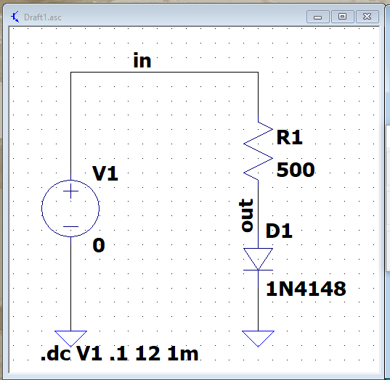
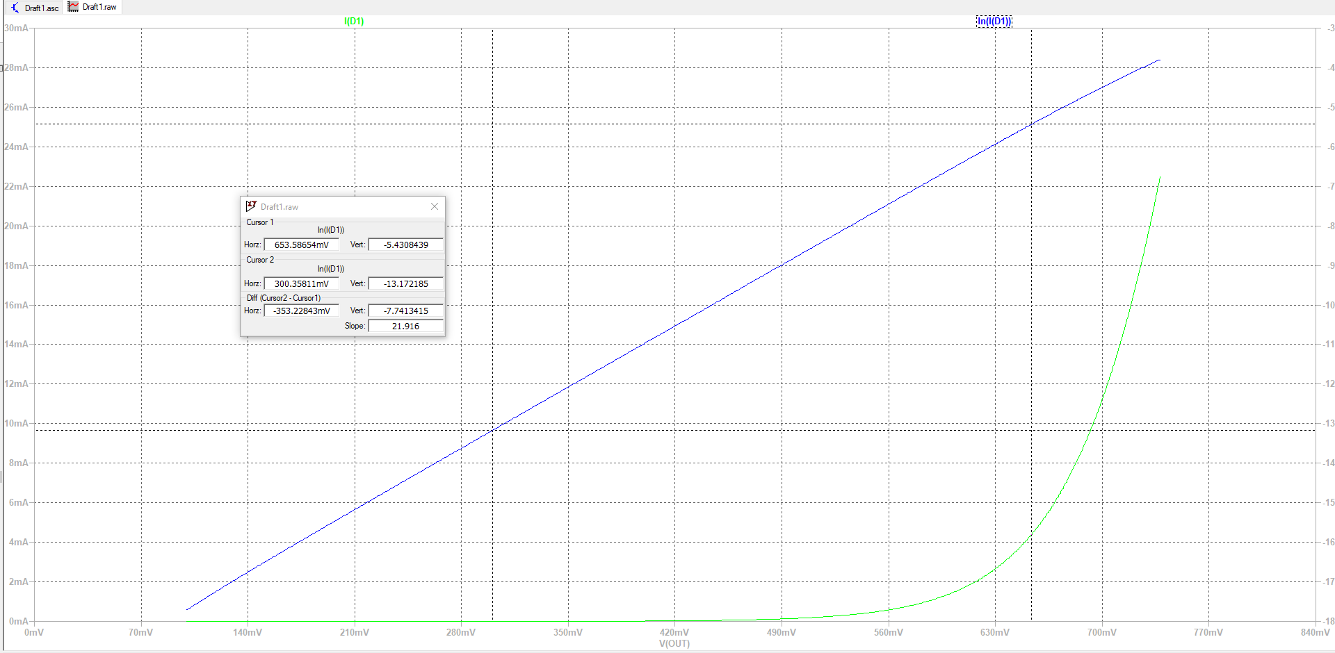
Start from building this circuit
Figure 64: Diode DC test setup
Figure 65: DC results for diode circuit. (Make sure to change the x-axis to V(out) or you will get a plot like Figure 66)

Slide 4

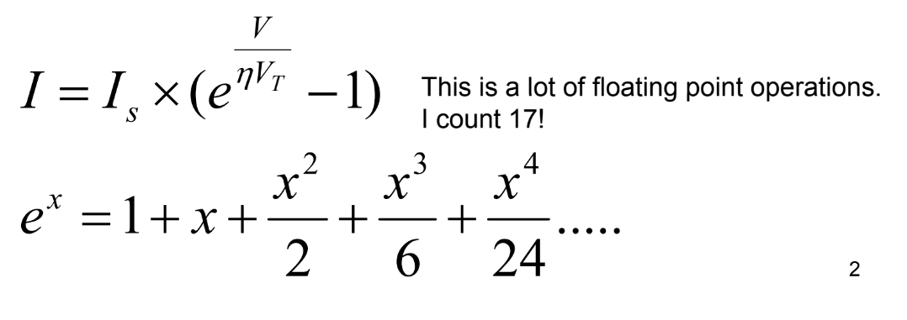



Diodes formula
This is I0, we are asking
This is n, we are asking
$$I= I_{0} × e^{\frac{V}{nV_{T}}}$$
For easier calculation we get rid of -1 term
$$ln(I)=\ln{(I_{0} × e^{\frac{V}{nV_{T}}})}$$
Take ln on both side
$$ln(I)=\ln\left(I_{0}\right)+ ln⁡( e^{\frac{V}{nV_{T}}})$$
$ln\left(I\right)=\ln\left(I_{0}\right)+\frac{1}{nV_{T}}V$

Slide 5
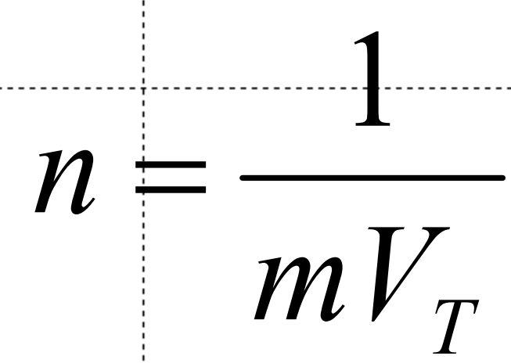

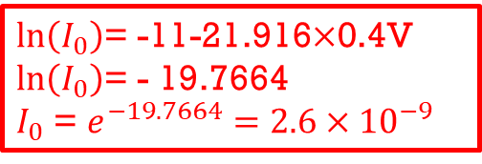


$$ln\left(I\right)=\ln\left(I_{0}\right)+\frac{1}{nV_{T}}V$$
$\ln\left(I_{0}\right)$= $ln\left(I\right)−$ $\frac{1}{nV_{T}}V$
Slope m
Thermal Voltage $V_{T}=0.0259$
In(I)= -11
$\ln\left(I_{0}\right)$= -11-21.916$×$0.4V
$\ln\left(I_{0}\right)$= - 19.7664
$I_{0}$ = $e^{−19.7664}=2.6×{10}^{−9}$
=$\frac{1}{21.916×0.0259}$ $=1.76173$
V=400mV
Figure 65: DC results for diode circuit. (Make sure to change the x-axis to V(out) or you will get a plot like Figure 66)

Slide 6
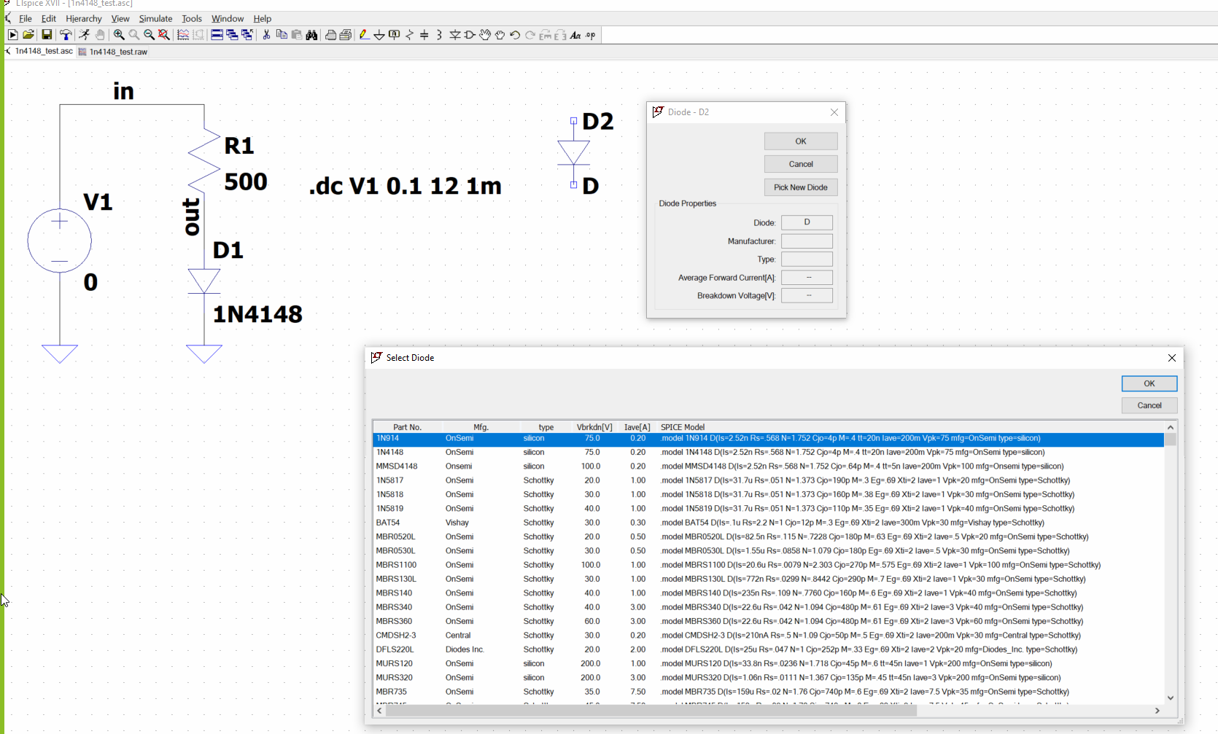
Go back to your schematic to check the calculation if it is correct
1. Left click and place anywhere
3. left click
2. Right click
Is=2.52n and N=1.752 close to the results

Slide 7
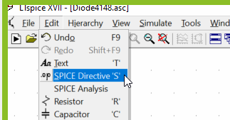
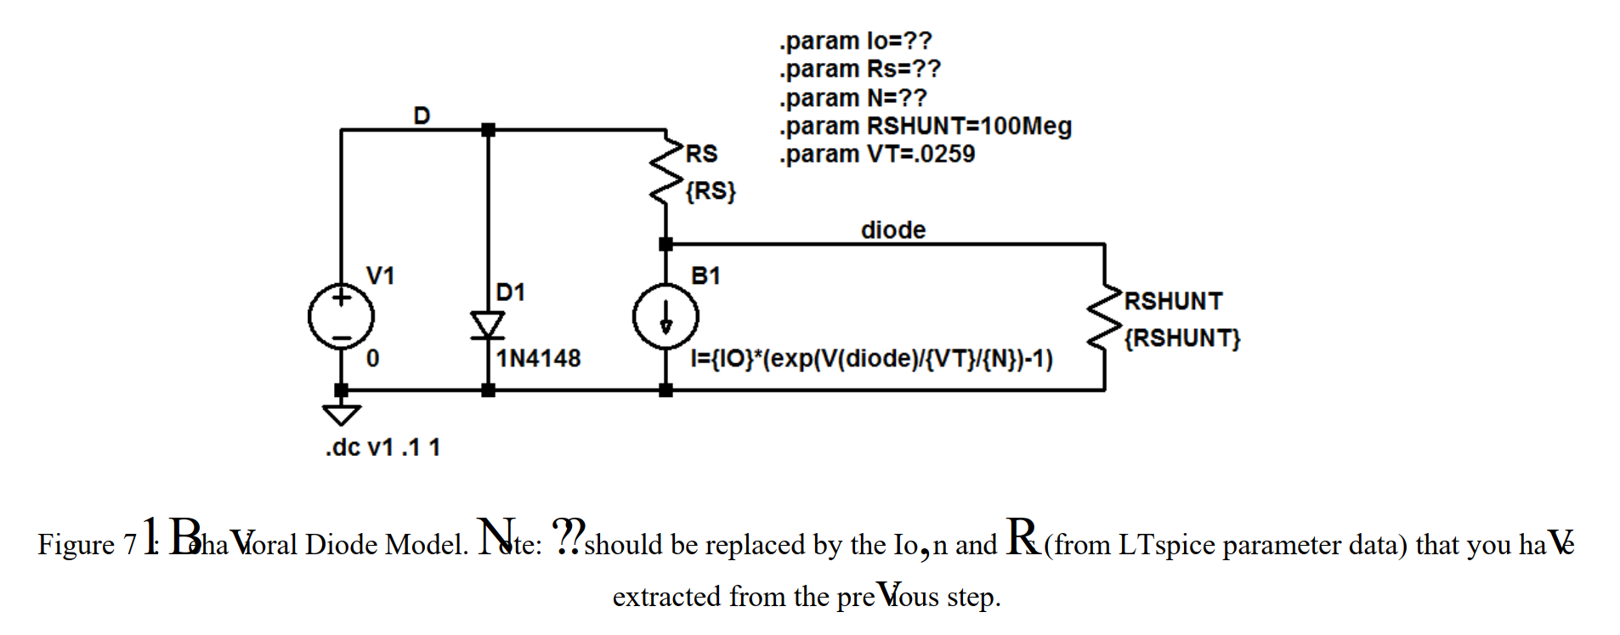
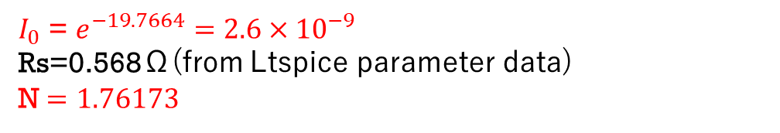
Build the following circuit with the previous calculated results
$I_{0}$ = $e^{−19.7664}=2.6×{10}^{−9}$
Rs=0.568Ω(from Ltspice parameter data)
N $=1.76173$

Slide 8
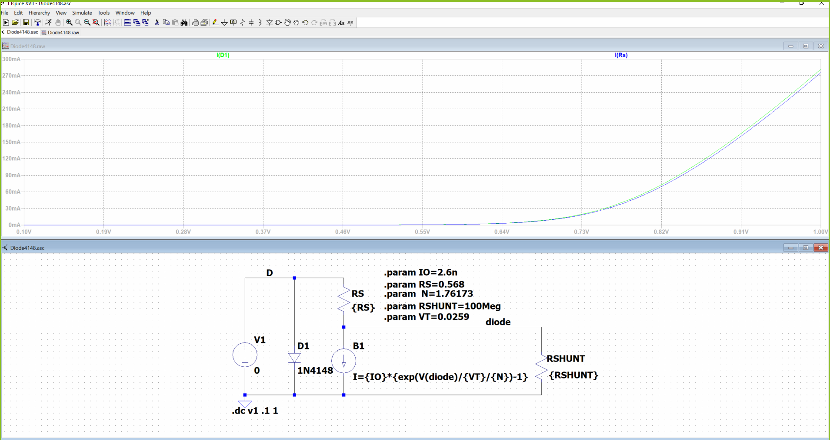
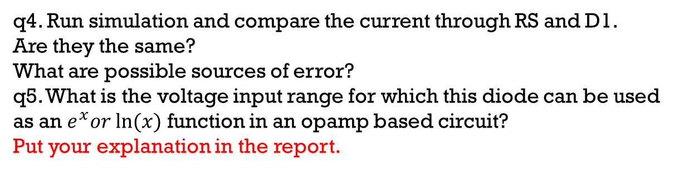
q4. Run simulation and compare the current through RS and D1.
Are they the same?
What are possible sources of error?
q5. What is the voltage input range for which this diode can be used
as an $e^{x}or ln⁡(x)$ function in an opamp based circuit?
Put your explanation in the report.

Slide 9
PART B

Slide 10
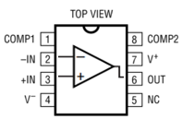
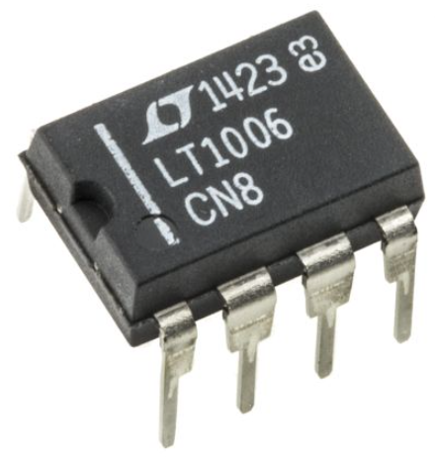
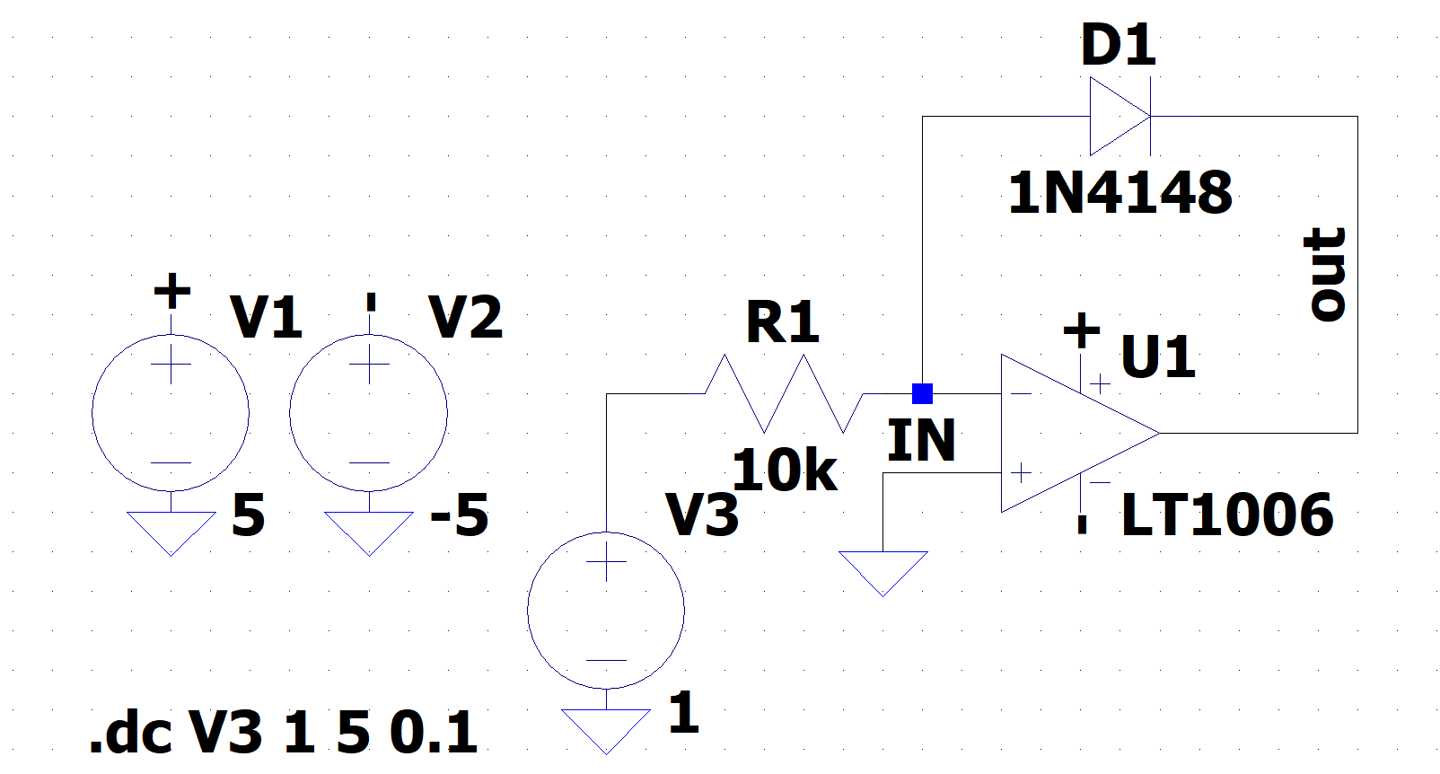
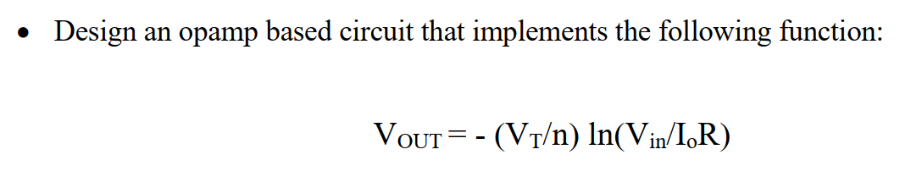
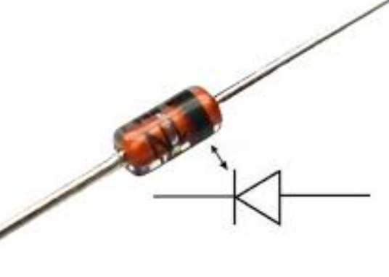
1. Connect the NATURAL LOG AMPLIFIER physically 2. Verify your design in LTSpice
notch
LT1006 pin config
V+
1+ or 2+
W1
gnd
V -
1N4148 Diode, black band represents cathode (-)
5 connections from your circuit to ADALM2000
LT1006 op-amp datasheet:
https://datasheetz.com/data/Integrated%20Circuits%20(ICs)/Amplifiers%20-%20Instrumentation,%20OP%20Amps,%20Buffer%20Amps/LT1006CN8-datasheetz.html

Slide 11
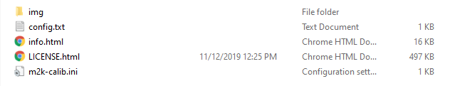

Please try to search ADALM2000 tutorial (recommend youtube)
Connect you ADALM2000 (made by Analog Devices) usb to your computer and open folder shown as below
Click on info
Download and install these two
https://www.youtube.com/watch?v=-ZpoaSnIGLY
You can look for some other tutorial links as well for easier understanding.

Slide 12
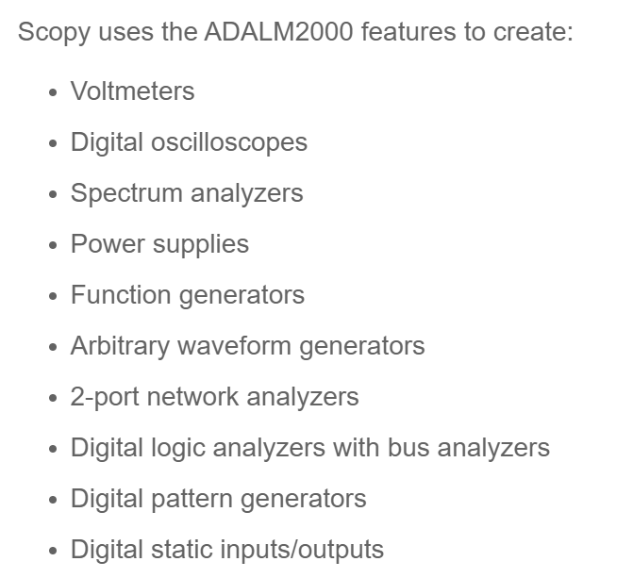
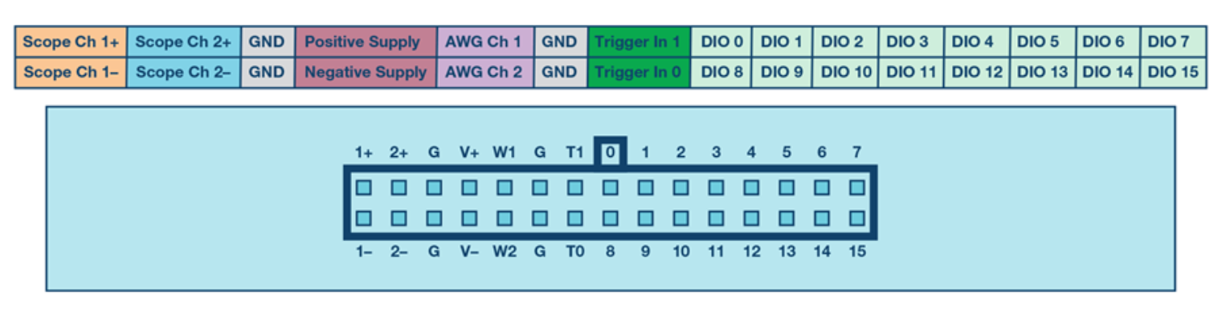
Adalm2000 PIN-OUT

Slide 13
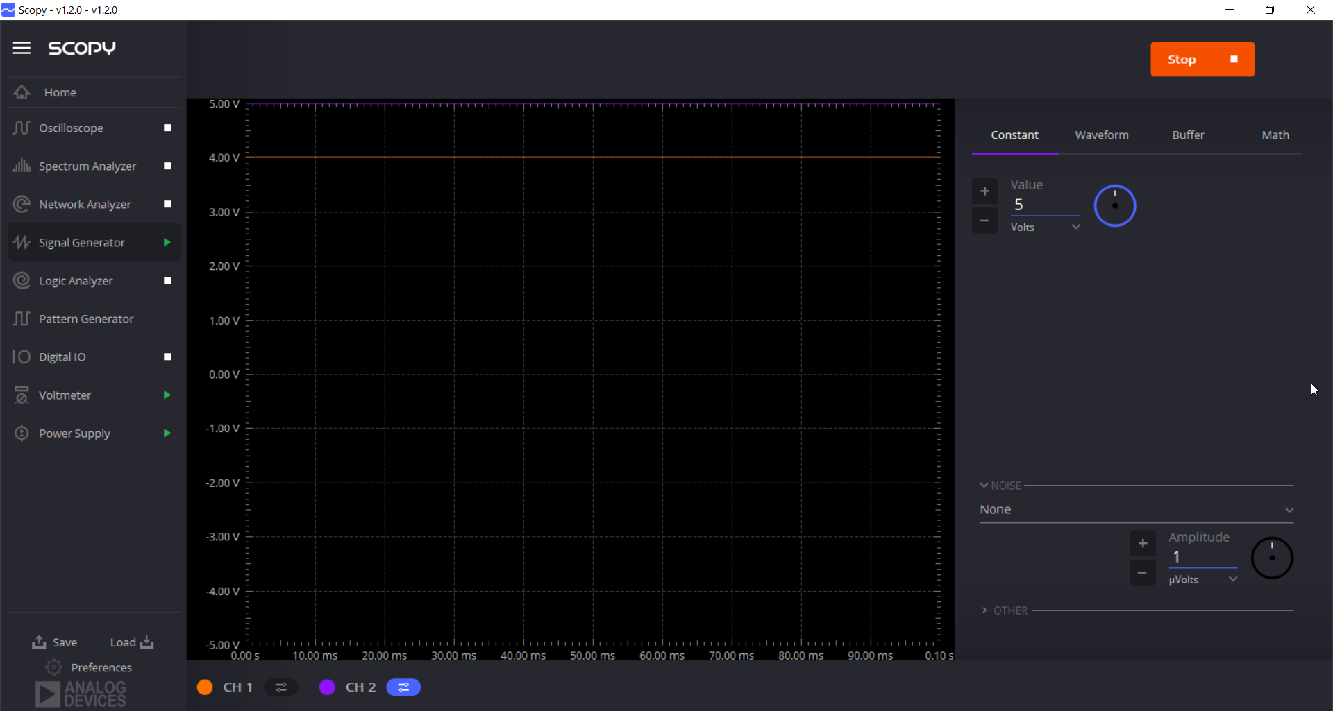
Signal generator Set V(in)=5V

Slide 14
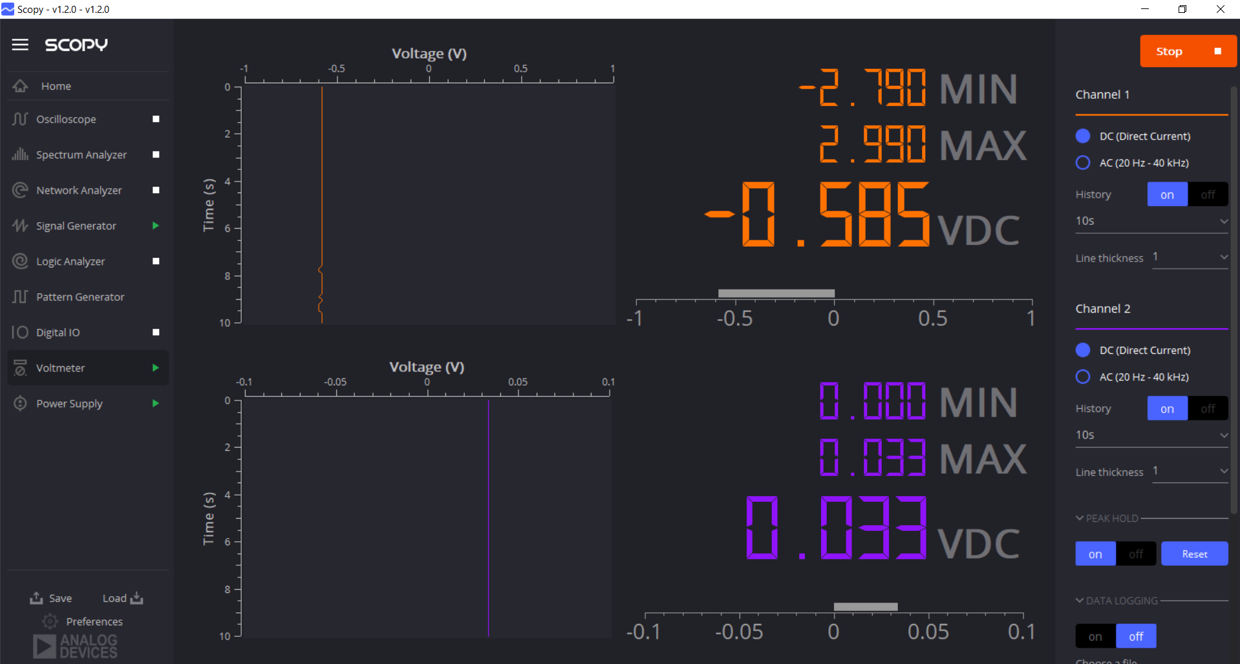
V(out) is shown in Voltmeter V(out) = - 0.585 in this graph

Slide 15
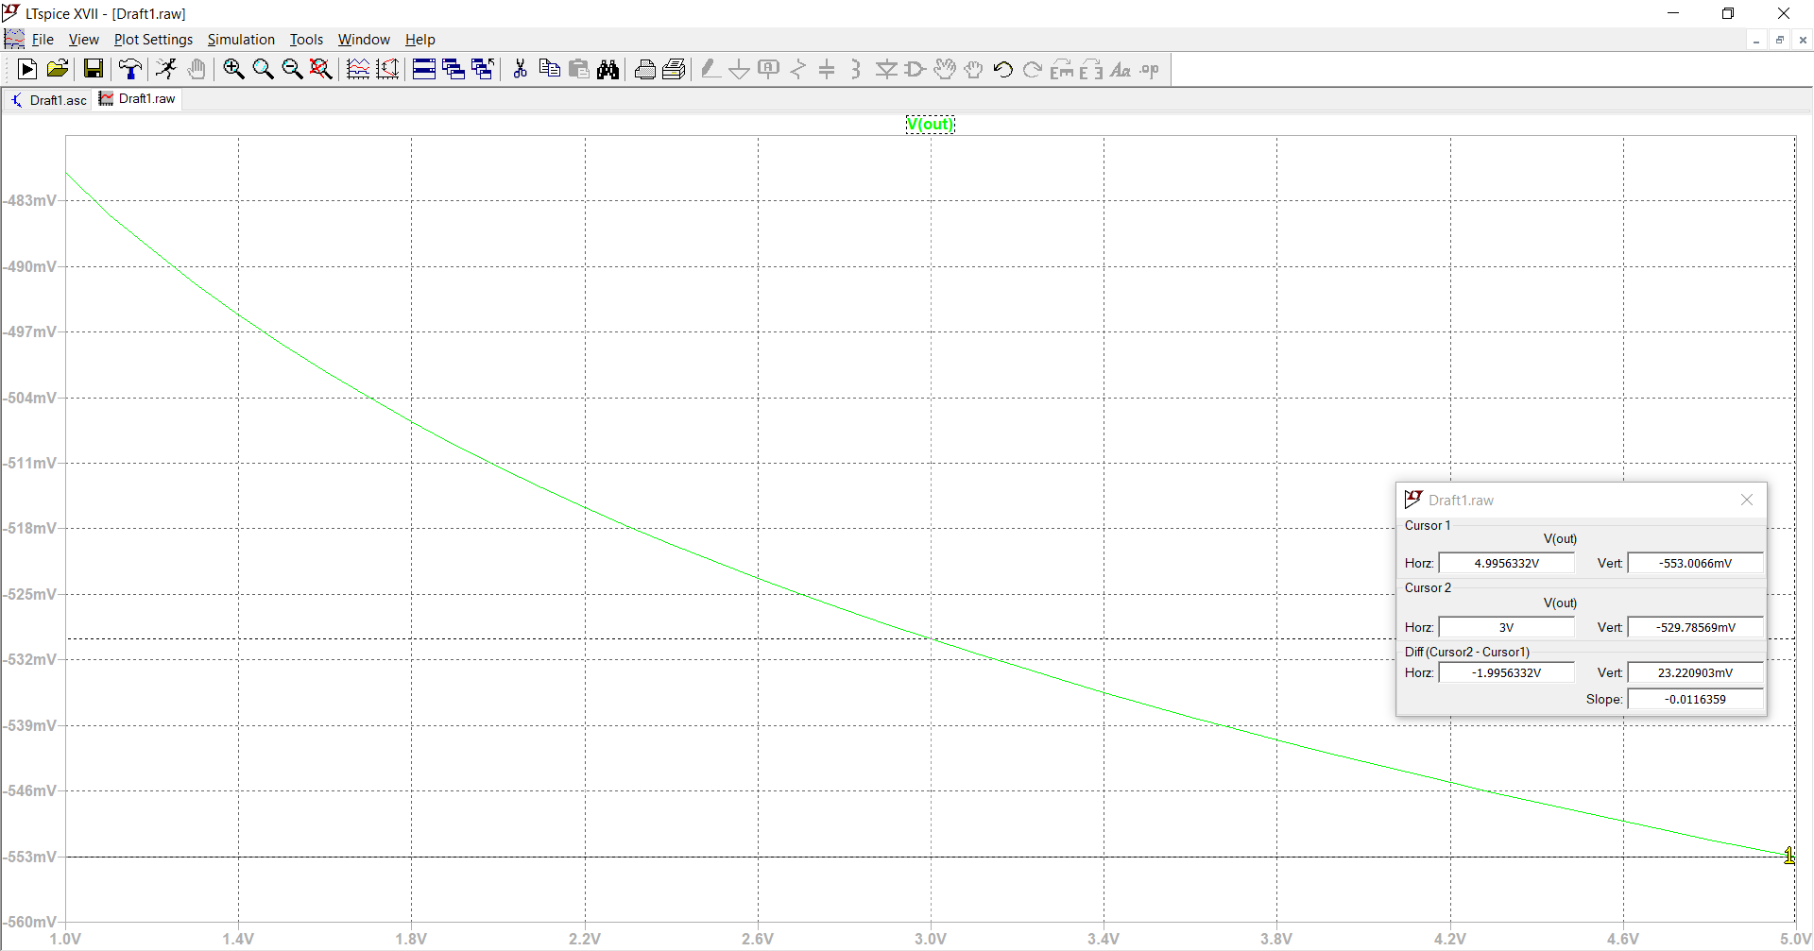
From LTspice simulation we notice when Vin = 5V, Vout = -553mV
Repeat the steps to check Vin = 1, 2, 3, 4 V

